Slide 1

Physiotherapy Treatment : A Classification and Configuration Design Expert System
Dimitris Nikolopoulos Fabio Curi Paixão

Slide 2
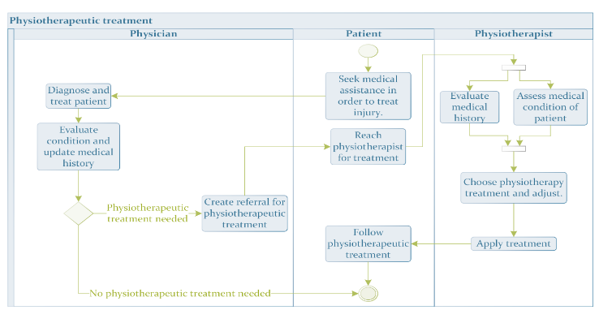
Organization model
Mission of the organization: provide physiotherapy treatments, according to the patient’s medical conditions and needs. The process is given below:

Slide 3
General functioning of the model
Input:
Medical Information => patient history, physiotherapy assessment and diagnosis from prior doctors.
System requirements => preferences and constraints
Patient’s: time schedule, physical limitation, handicap (...)
Physiotherapists’: time schedule, equipment (...)
Output:
a configured class of physiotherapy treatment.
Notes:
Here:

Slide 4
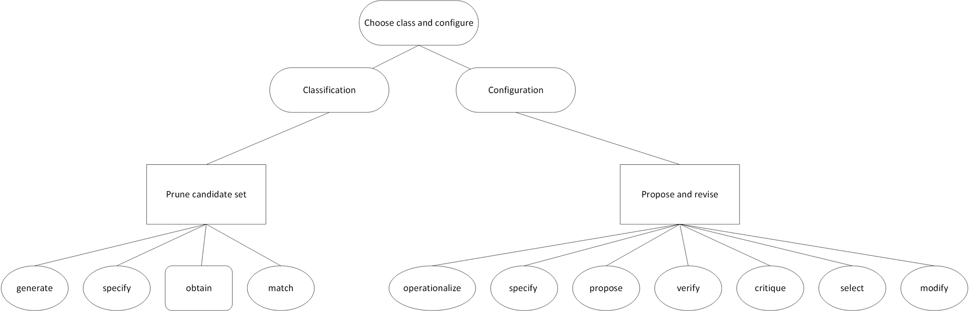
Task decomposition

Slide 5
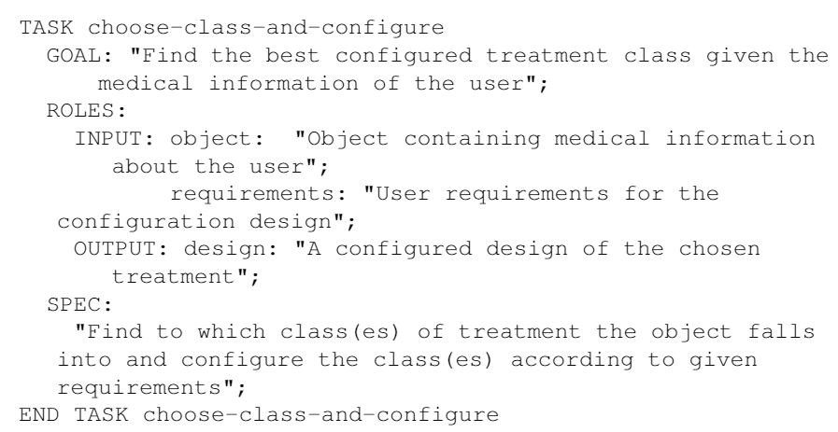
Task knowledge

Slide 6
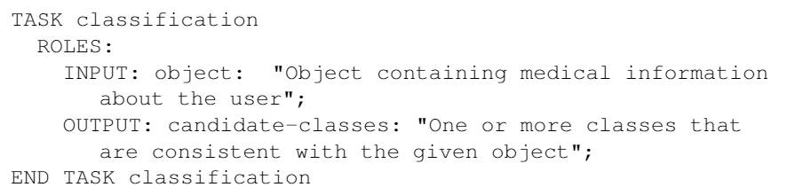
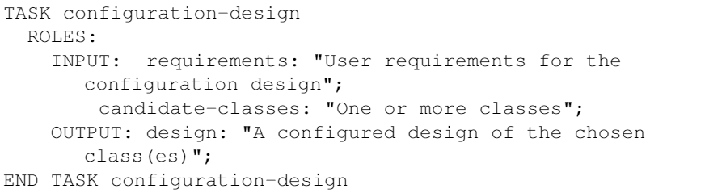
Task knowledge
Task 1: Classification
Task 2: Configuration

Slide 7
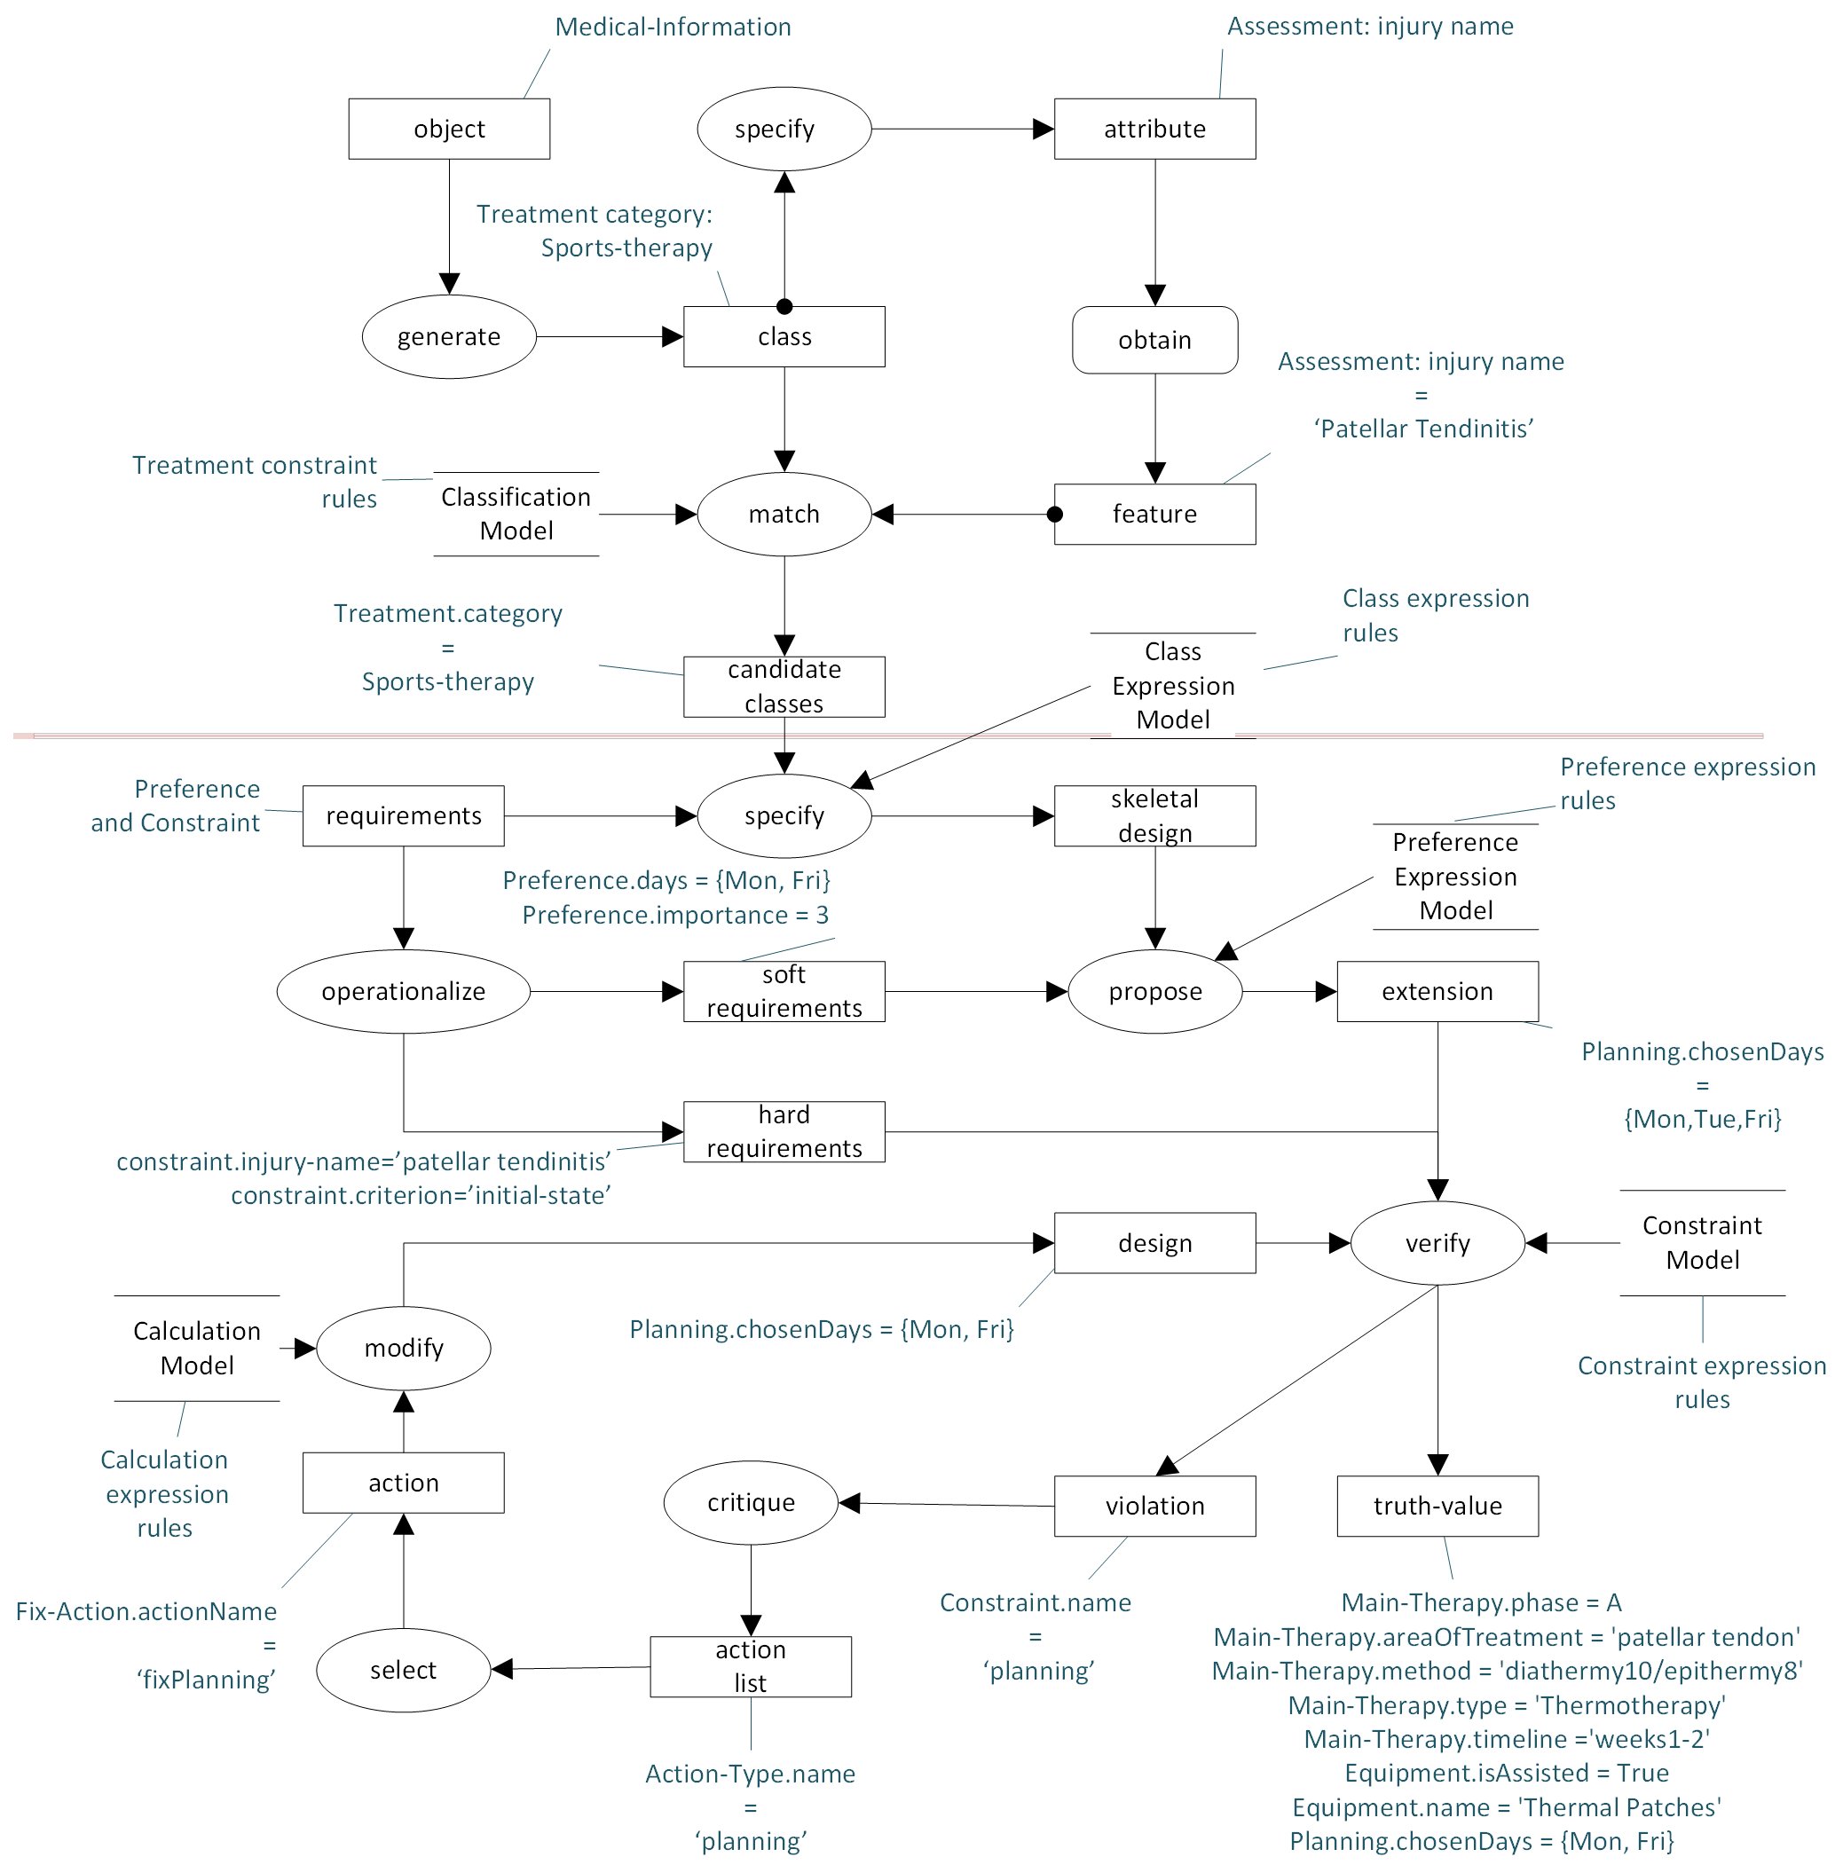
Inference knowledge (1/2)

Slide 8
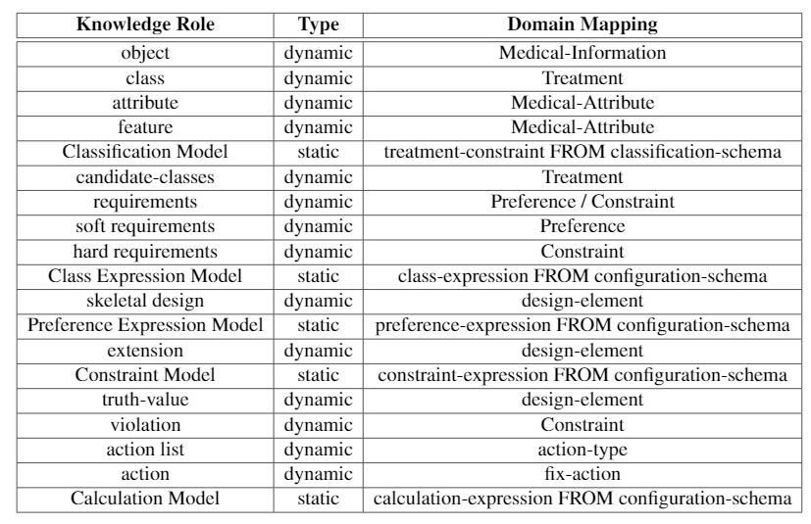
Inference knowledge (2/2)
Classification:
prune candidate set
Configuration design:
propose and revise

Slide 9
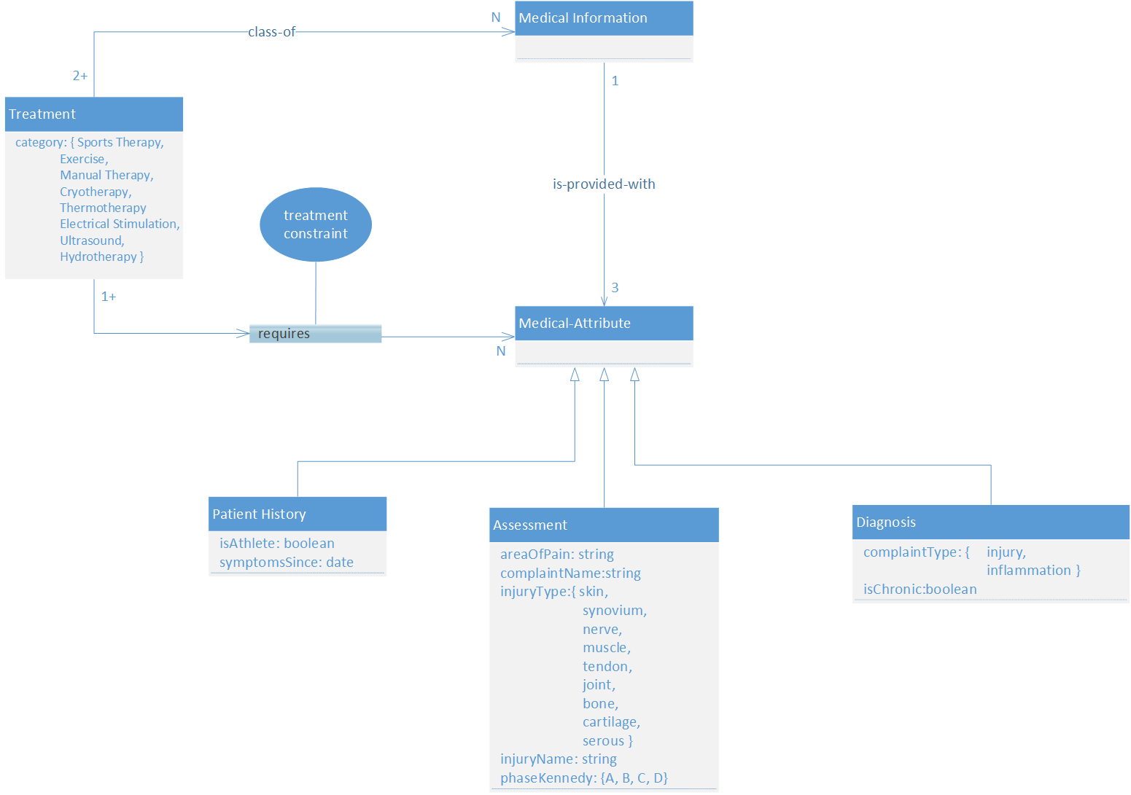
Domain knowledge - Classification task
Input object
classes

Slide 10
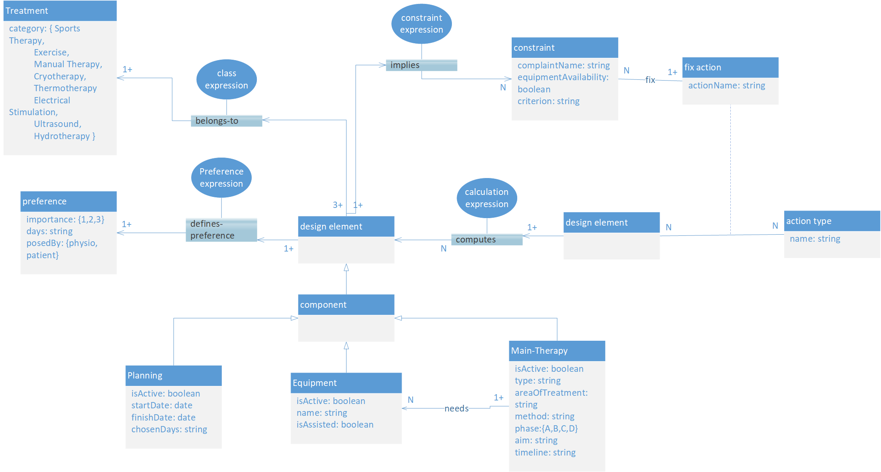
Domain knowledge - Configuration design task
skeletal design
revision

Slide 11
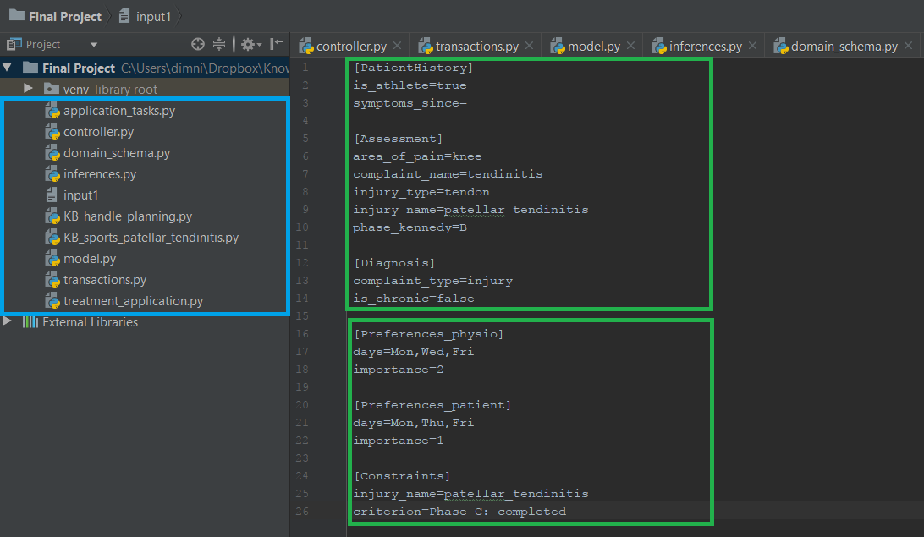
Demo (1/3)

Slide 12
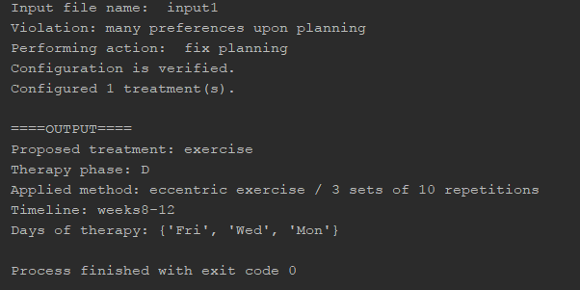
Demo (2/3)

Slide 13
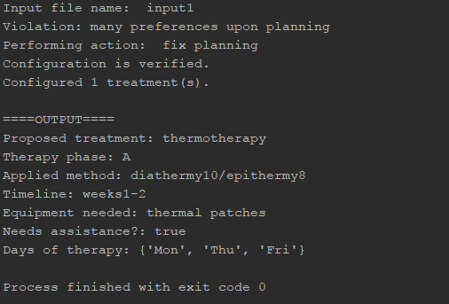
Demo(3/3)
Input:
More importance to physiotherapist’s preferences
Phase of treatment: A instead of D

Slide 14
Reflection
Model re-adjustments might be needed:
Domain schema
More Knowledge Bases
Template tasks
(...)
Very large domain Ontology is a must
Exact mapping from Knowledge Model to code not always practical

